Slide 1
Bias Variance tradeoff
Mahipal Singh

Slide 2
Bias (Underfitting)
Bias refers to the error due to overly simplistic assumptions in the learning algorithm. A model with high bias tends to underfit the data, meaning it oversimplifies the underlying patterns. This leads to poor predictive performance as the model cannot capture the complexity of the real-world problem.

Slide 3
Variance (Overfitting)
Variance, on the other hand, is the error due to excessive complexity in the learning algorithm. A model with high variance captures not only the underlying patterns but also the noise in the training data. This leads to poor generalization to unseen data.

Slide 4
The bias-variance tradeoff
If our model is too simple and has very few parameters then it may have high bias and low variance.
On the other hand if our model has large number of parameters then it’s going to have high variance and low bias. So we need to find the right/good balance without overfitting and underfitting the data.
This tradeoff in complexity is why there is a tradeoff between bias and variance. An algorithm can’t be more complex and less complex at the same time.

Slide 5
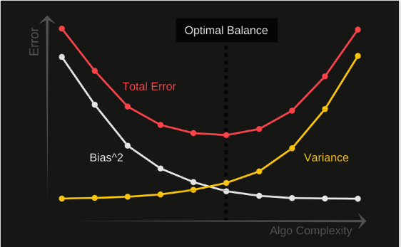

Slide 6
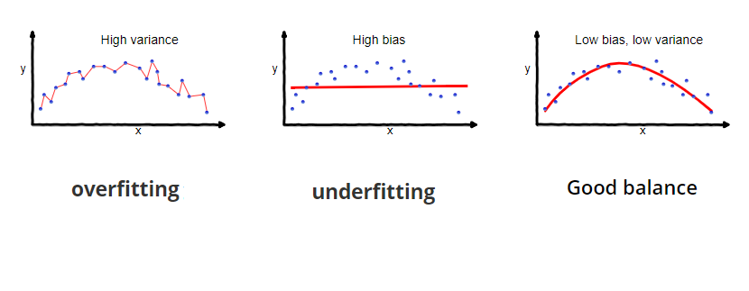

Slide 7
Bias-Variance Tradeoff is applicable in various machine learning use cases, including:
Financial Forecasting: Achieving accurate predictions for stock prices, market trends, and investment opportunities.
Medical Diagnostics: Building reliable models for disease diagnosis and patient risk assessment.
Customer Behavior Analysis: Understanding customer preferences and optimizing marketing strategies.
Natural Language Processing: Developing language models for sentiment analysis, chatbots, and text generation.

Slide 8
Several related concepts and techniques contribute to understanding and managing the bias-variance tradeoff:
Regularization: A technique used to control model complexity and prevent overfitting by penalizing large parameter values.
Cross-Validation: A method to evaluate a model's performance on multiple data subsets, helping to estimate bias and variance.
Ensemble Methods: Combining multiple models to reduce variance and improve overall predictive performance.
Feature Selection: Choose relevant features.
Collect More Data:

